Slide 1
Major Project: Student Management Software
Global College of Science and Technology
Participants:
Avinandan Bose
DebJyoti Ghosh
Instructor : Prodip deb

Slide 2
INTRODUCTION
There is very growth of university, colleges and educational intuition in India. In addition, numerous companies and industries are arriving India and India is growing the same to have better business around world.
Therefore, there is huge inflow and outflow of data around the world. To store the data and process it, we need offline and online software and programming.
Mainly advent of Computer, calculator and software introduced to process simple to complex calculation.
However, today other than that storing small data to huge amount data in a secure locker like bank is a tough challenge.
Here locker is todays Database that stores huge amount data.
My project complies with storing, retrieving data and calculation of data. Every institute manages its employees or an educational intuition manages data of students.
My project based on the same concept of managing data of college and university admitted student, and payment of each students, retrieving their data and payments with calculations.

Slide 3
Hardware Specification
Maximum System Requirements
*RAM-2GB.
*HARD DISK-5GB.
*PROCESSOR-INTEL PENTIUM 4.
*KEYBOARD-104 Keys.
*Mouse.
*OS: Linux/Windows.

Slide 4
Software Requirements
*XAMP/WAMP for Windows for SQL and Apache connection.
*LAMP for Linux.
*Java Swing and AWT(Abstract Window Toolkit) GUI(Graphical User Interface) platform like Eclipse and NetBeans.
*JDBC(Java Database Connectivity).

Slide 5
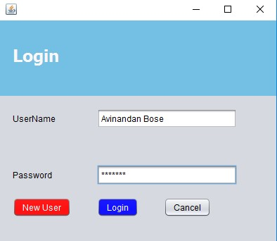
LOGIN PAGE
When we open the Application we get this page.
We have to enter username and password to have our next window.
If we are new user, then we have to go to new user option .
New user is to register for new user.

Slide 6
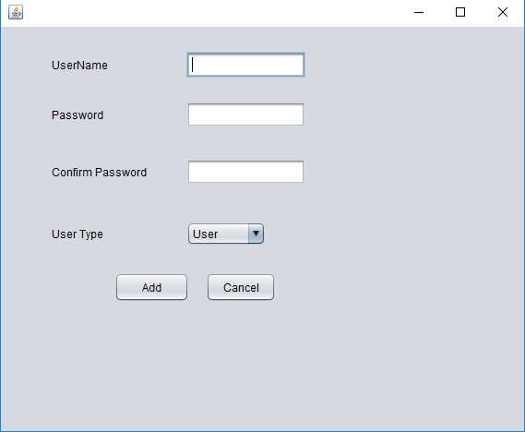
New User
This window is for registering the new user and declaring its user type.
It has name and password, through which we can log in.

Slide 7
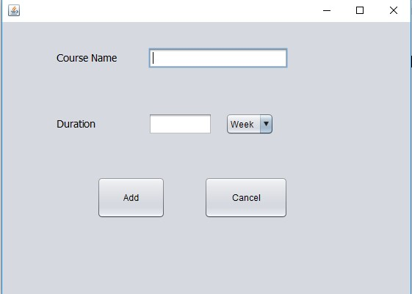
Course
It has course name and duration.
The add button which will add course name and duration to database.
Cancel will close the window.

Slide 8
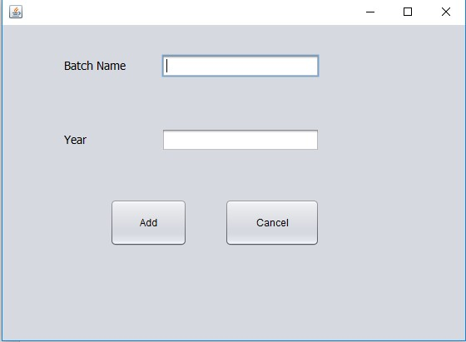
Batch
It has batch name and duration.
Add button will add both to the database .
Cancel will close the window.

Slide 9
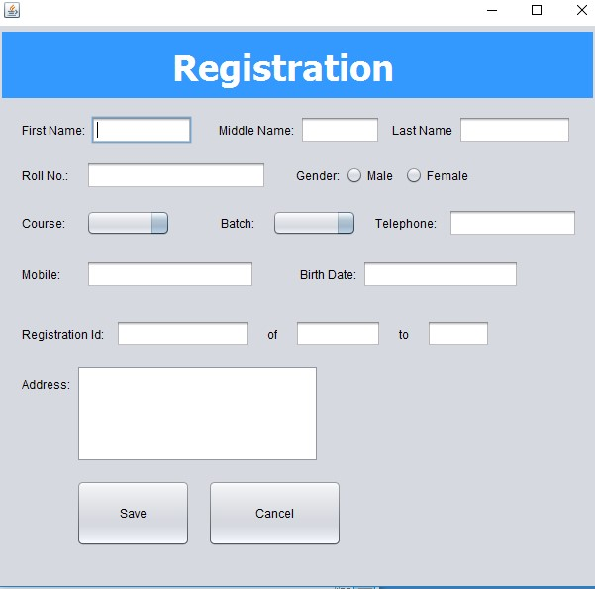
Registration
Registration have First , Middle and Last Name.
It also has Roll No, Gender choice – male and female , course, batch, telephone , mobile, birth date, registration id and address.
Save will save all data to registration database.
Cancel will close the window.

Slide 10
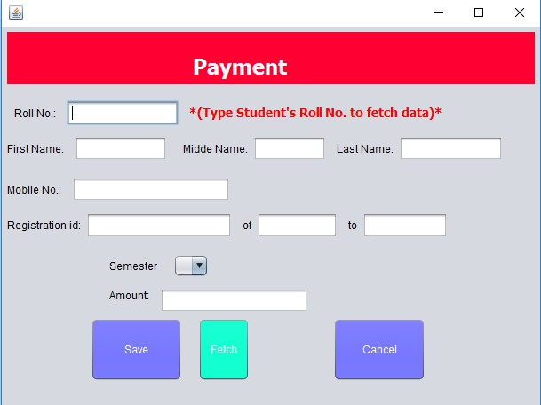
Payment
Just type the roll no. and click on the fetch button to get the data of student according to roll no. from the registration database.
Then put Semester and amount and save it to database.
Cancel is to close the window.

Slide 11
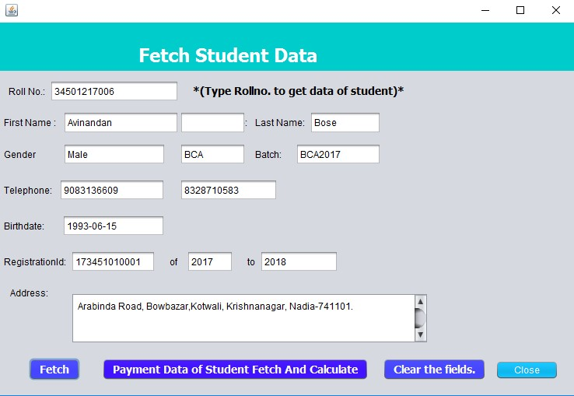
Fetch Student Data
Just click on fetch, to get all the fields of the student’s data entered during registration.

Slide 12
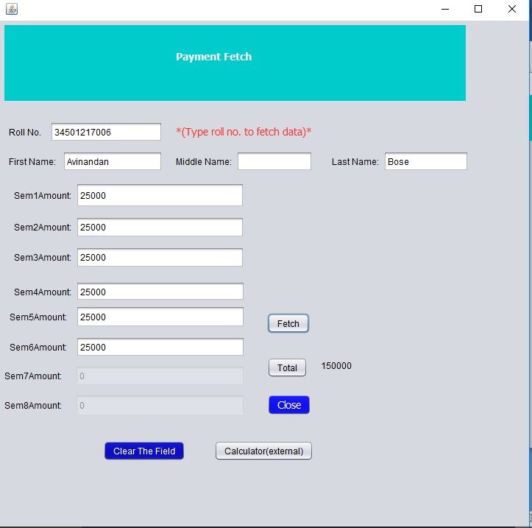
Payment Data Fetch
Just type the roll no. and click on fetch to get all the Semester payment .
it will automatically calculate the total of all semesters and present it to the window.
Clear the field button will clear all the fields.

Slide 13
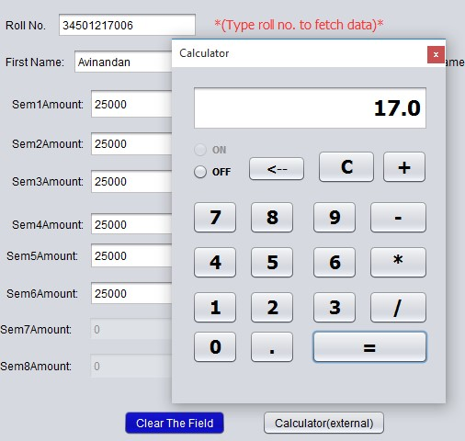
Calculator
The calculator is used to calculate the semester total if needed.
However, its function is not limited to only calculating total but it has numerous function too of a simple calculator.

Slide 14
Conclusion
Hence it is concluded that the project that the Student Management Software maintains entering and storing data of Student study in an intuition .
It also helps in calculation part .
There are scope of improvement of the software such as uploading pics of student and storing them into database.
It’s a simple software of which we can show how a student data maintained by an intuition .

Slide 15
End of Presentation

